Slide 1
Merging / Joining Datasets

Slide 2
The Data Science Pipeline

Slide 3
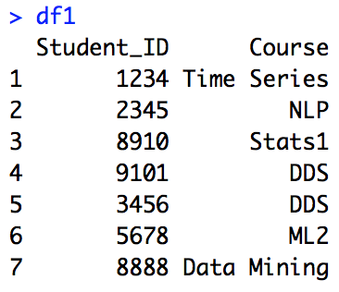
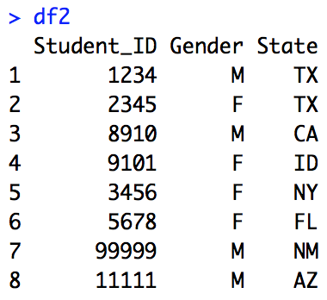
Example: Data Set: Students and Courses
Primary Key: a variable that uniquely identifies an observation in its own table. For example, df1$Student_ID is a primary key for df1 because it uniquely identifies each student in df1. (df2$Student_ID is also a primary key for df2.)
Foreign Key: a variable in one table that uniquely identifies a row of another table. For example, df2$Student_ID is a foreign key since it uniquely identifies a student in df1.
Note: In this case df1$Student_ID and df2_Student_ID are both primary in their respective datasets and foreign keys with respect to each other. We will see an example shortly where a variable is a foreign key but not a primary key.
df1 = data.frame(Student_ID = c("1234", "2345", "8910", "9101", "3456", "5678","8888"), Course = c("Time Series", "NLP", "Stats1", "DDS", "DDS", "ML2","Data Mining"))
df2 = data.frame(Student_ID = c("1234", "2345", "8910", "9101", "3456", "5678","99999", "11111"), Gender = c("M", "F", "M", "F", "F", "F", "M", "M"), State = c("TX", "TX", "CA", "ID", "NY", "FL","NM", "AZ") )

Slide 4
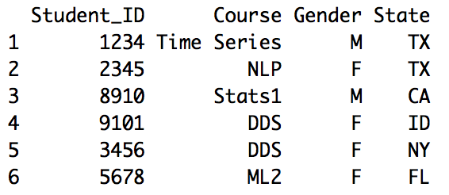
Example: Inner Join | merge(), inner_join()
Inner Join: matches pairs of observations whenever their keys are equal. In other words, an inner join combines only observations that are in both datasets.
#inner join
merge(df1,df2, by = "Student_ID")
#or
inner_join(df1,df2,by = "Student_ID")
#or
df1 %>% inner_join(df2,by = "Student_ID")

Slide 5
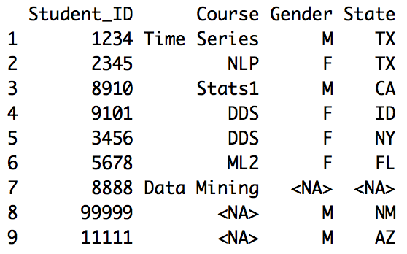
Example: Outer Join | merge(), outer_join()
Outer Join: includes all observations and fills in NAs when values are missing.
#outer join
merge(df1,df2, by = "Student_ID",all = TRUE)
#or
full_join(df1,df2,by = "Student_ID")
#or
df1 %>% full_join(df2,by = "Student_ID")

Slide 6
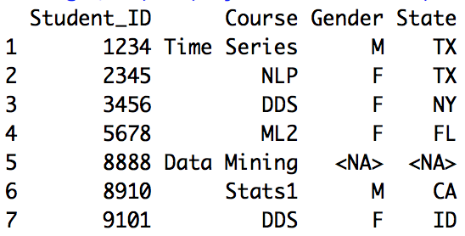
Example: Left Join| merge, left_join()
Left Join: matches pairs of observations in the “left” dataset that have a match in the “right” dataset and fills in NAs when no matches exist. For example, every observation in the df1 (“left”) dataset is matched with a corresponding observation in df2 (“right”) dataset and 8888 is imputed with NAs.

Slide 7
Example: Left Join| merge, left_join()
Left Join: matches pairs of observations in the “left” dataset that have a match in the “right” dataset and fills in NAs when no matches exist. For example, every observation in the df1 (“left”) dataset is matched with a corresponding observation in df2 (“right”) dataset and 8888 is imputed with NAs.
#left join
merge(df1,df2, by = "Student_ID",all.x = TRUE)
left_join(df1,df2, by = "Student_ID")

Slide 8
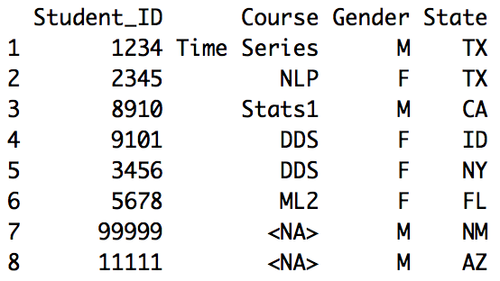
Example: Right Join| merge, right_join()
Right Join: matches pairs of observations in the “right” dataset that have a match in the “left” dataset and fills in NAs when no matches exist. For example, every observation in the df2 (“right”) dataset is matched with a corresponding observation in df2 (“left”) dataset and Course values for 99999 and 11111 are imputed with NAs.
#right join
merge(df1,df2, by = "Student_ID",all.y = TRUE)
right_join(df1,df2, by = "Student_ID")

Slide 9
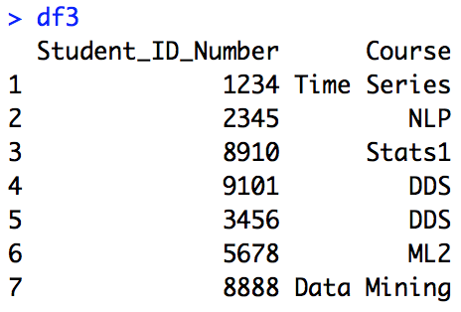
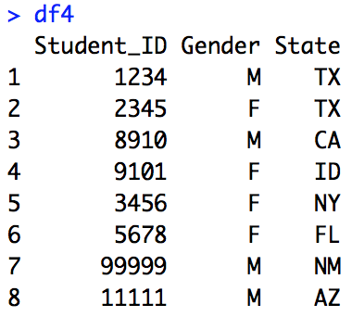
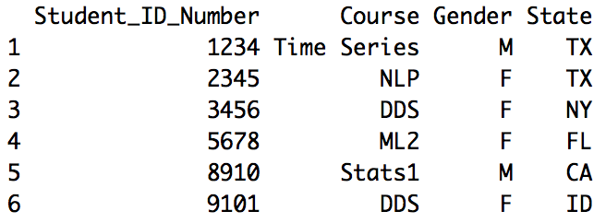
Example: Joins with Different Key Names
Inner Join: matches pairs of observations whenever their keys are equal. In other words, an inner join combines only observations that are in both datasets.
merge(df3,df4, by.x = "Student_ID_Number", by.y = "Student_ID")
#Different Column Names: by.x and by.y
df3 = data.frame(Student_ID_Number = c("1234", "2345", "8910", "9101", "3456", "5678", "8888"), Course = c("Time Series", "NLP", "Stats1", "DDS", "DDS", "ML2", "Data Mining"))
df4 = data.frame(Student_ID = c("1234", "2345", "8910", "9101", "3456", "5678","99999", "11111"), Gender = c("M", "F", "M", "F", "F", "F", "M", "M"), State = c("TX", "TX", "CA", "ID", "NY", "FL","NM", "AZ") )

Slide 11
Example: AcuSpike
Merging and Creating a Heat Map

Slide 12

AcuSpike

Slide 13
Acuspike Merge and HeatMap
#Data clean and heat map for Acuspikes
# Data has been read into a Dataframe called "Acu"
library(ggplot2)
library(maps)
library(dplyr)
Acu = read.csv(file.choose(),header = TRUE) # read in company data
lookup = data.frame(abb = state.abb, State = state.name) #makes a data frame with State name and abbreviation.
colnames(Acu)[2] = "abb" # Change Column Name
Acu2 = merge(Acu,lookup,"abb") # make one dataset with state names and abb
AcuMapData = count(Acu2,State) #count up the occurrence of each state.
#AcuMapData = AcuMapData[-c(5,9,43),] #Shows contrast between other states better
colnames(AcuMapData)[2] = "AcuSpikes" #change "n" to "Acuspike"
AcuMapData$region <- tolower(AcuMapData$State)
AcuMapData2 = AcuMapData[-1]
states <- map_data("state")
map.df <- merge(states,AcuMapData, by="region", all.x=T)
map.df <- map.df[order(map.df$order),]
ggplot(map.df, aes(x=long,y=lat,group=group))+
geom_polygon(aes(fill=AcuSpikes))+
geom_path()+
scale_fill_gradientn(colours=rev(heat.colors(10)),na.value="grey90")+ggtitle("Acuspike Systems by State")
coord_map()

Slide 14
AcuSpike Heatmap

Slide 16
Example: WDI
GDP Per Capita Versus Life Expectancy

Slide 17
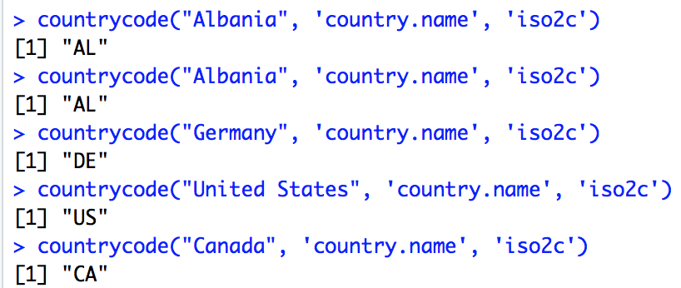
WDI: GDP Per Capita Versus Life Expectancy
iso2c country codes
install.packages("countrycode")
library(countrycode)
countrycode("Albania", 'country.name', 'iso2c')
countrycode("Germany", 'country.name', 'iso2c')
countrycode("United States", 'country.name', 'iso2c')
countrycode("Canada", 'country.name', 'iso2c')

Slide 18
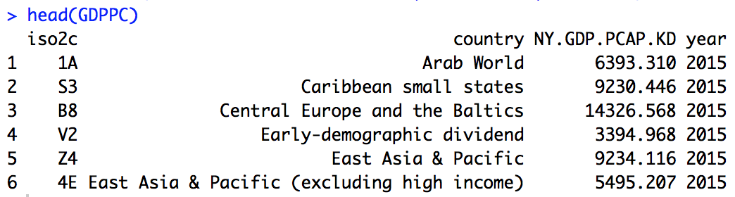
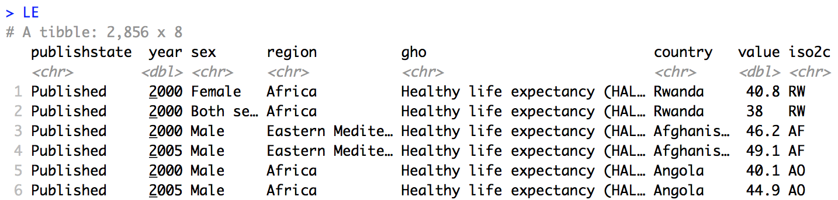
WDI: GDP Per Capita Versus Life Expectancy
Load Both Data Sets
library(WDI)
#GDP ("NY.GDP"), Per capita ("PCAP"), in US Currency (KD)
GDPPC = WDI(indicator="NY.GDP.PCAP.KD", start=2015, end=2015)
head(GDPPC)
library(WHO)
codes <- get_codes()
str(codes)
dim(codes)
names(codes)
grep("life expect",codes$display)
# another way instead of grep
#which(str_detect(codes$display,"life expect"))
codes$display[58]
codes$display[2187]
codes$label[58]
codes[58,]
#58th codes has label "WHOSIS_000002"
LE = get_data("WHOSIS_000002")
LE$iso2c = countrycode(LE$country, 'country.name', 'iso2c')
LE

Slide 19
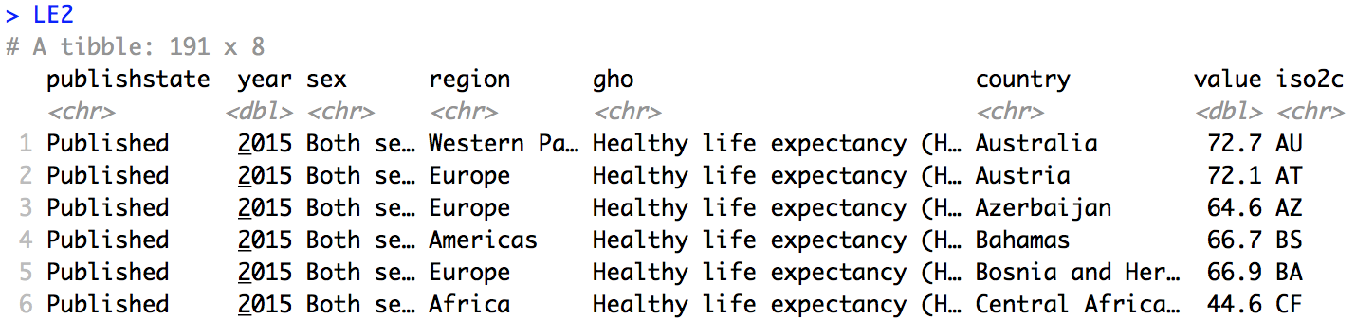
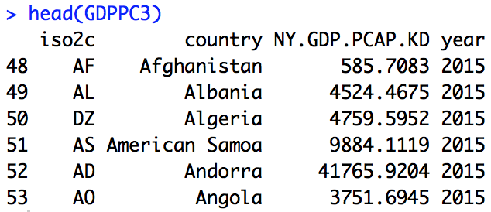
WDI: GDP Per Capita Versus Life Expectancy
LE2 = LE %>% filter(sex == "Both sexes" & year == 2015)
LE2
GDPPC2 = GDPPC[48:264,] #These are the rows of the indiviudal countries rather than regions
GDPPC3 = GDPPC2[!is.na(GDPPC2$NY.GDP.PCAP.KD),]
head(GDPPC3)

Slide 20
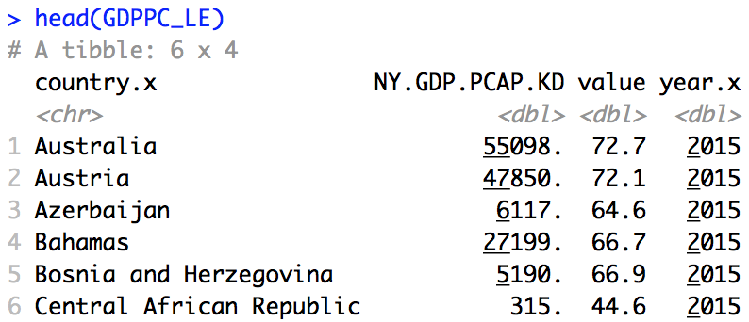
WDI: GDP Per Capita Versus Life Expectancy
Clean and Merge Datasets
GDPPC2 = GDPPC[48:264,] #These are the rows of the indiviudal countries rather than regions
GDPPC3 = GDPPC2[!is.na(GDPPC2$NY.GDP.PCAP.KD),]
head(GDPPC3)
dim(GDPPC2)
dim(GDPPC3)
# Try and get a GDP for every country in the LE2 set.
GDPPC_LE = left_join(LE2,GDPPC3,"iso2c") %>% select(country.x,NY.GDP.PCAP.KD,value,year.x)
head(GDPPC_LE)
http://worldhappiness.report/ed/2019/

Slide 21
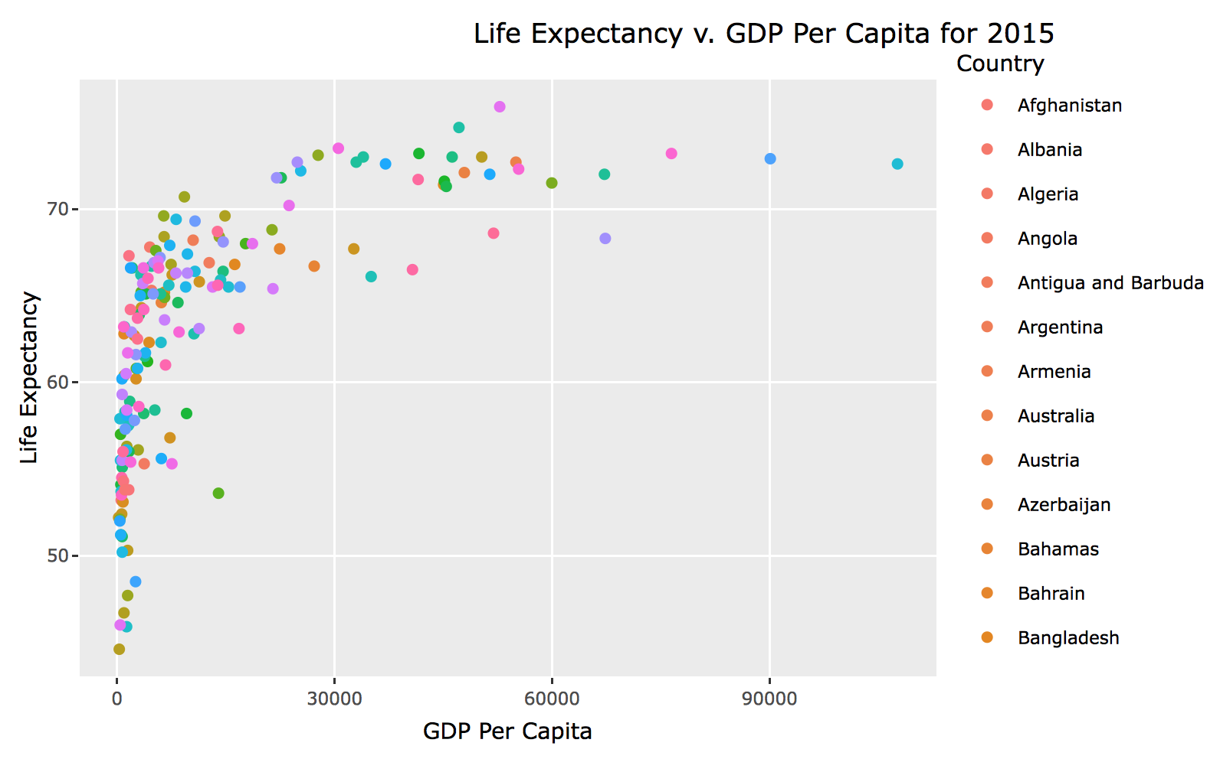
WDI: GDP Per Capita Versus Life Expectancy
Plot the Merged Data
library(plotly)
names(GDPPC_LE)[1] = "Country"
ThePlot = GDPPC_LE %>%
ggplot(aes(NY.GDP.PCAP.KD,value,color = Country)) + geom_point() + xlab("GDP Per Capita") + ylab("Life Expectancy") + ggtitle("Life Expectancy v. GDP Per Capita for 2015")
ggplotly(ThePlot)

Slide 23
String Basics| base and stringr

Slide 24
String Basics
string1 = "Don't let what you can't do interfere with what you can do."
string2 = "\"Don't let what you can't do interfere with what you can do.\" - John Wooden"
writeLines(string2)
x = "\u00b5"
x
x = "\\u00b5"
x
string3 = c("IF","YOU","GET","GIVE,", "IF","YOU","LEARN","TEACH")
string3
#strinr functions
str_length(string3)
#Collapse Strings... put them together
str_c(string3)
#Collapse Strings... put them together
str_c(string3, collapse = "")
#Collapse Strings... put them together
str_c(string3, collapse = ",")
#Collapse Strings... put them together
str_c(string3, collapse = " ")
string4 = str_c(string3, collapse = " ")
str_sub(string4,1,1)
str_sub(string4,1,7)
str_sub(string4,-3,-1)
str_sub(string4,-14,-1)
str_sub(string4,3,7)

Slide 26
Basic Matching| base and stringr

Slide 27
Famous Quotes
“In a gentle way, you can shake the world.” - Gandhi
“I've missed more than 9000 shots in my career. I've lost almost 300 games. 26 times, I've been trusted to take the game winning shot and missed. I've failed over and over and over again in my life. And that is why I succeed.”
– Michael Jordan
“If you get give, if you learn teach.” – Maya Angelou
“Don't let what you can't do interfere with what you can do.” – John Wooden

Slide 28
Basic Matches: str_view and escape (\)
# Regular Expressions
string5 = " \"I've missed more than 9000 shots in my career. I've lost almost 300 games. 26 times, I've been trusted to take the game winning shot and missed. I've failed over and over and over again in my life. And that is why I succeed.\"
– Michael Jordan"
str_view(string5, "shot")
str_view_all(string5,"shot")
str_view_all(string5,"I")
str_view_all(string5," I ")
str_view_all(string5,"(\\. I| \"I)") #Find "I" at the beginning of a sentence.
#How can we count how many times it comes up in the string? The answer is coming.
str_view(string1, "career\\.") # need \\. because \ is an escape in both strings and regular expressions
str_view_all(string1,"\\. I") #Find "I" at the beginning of a sentence.

Slide 30
Anchors: ^ and $
string6 = " \"Sometimes when you innovate, you make mistakes. It is best to admit them quickly, and get on with improving your other innovations.\" - Steve Jobs"
str_view(string1, "^Don't")
str_view(string3, "^T")
str_view(string6, "^\"Some") #Why Nothing ... we will come back to this.
str_view(string6, "Jobs$")
#Find digits and whitespace
str_view(string5,"\\d")
str_view_all(string5,"\\d")
str_view_all(string6,"\\s") #Ahh... there was white space
str_view(string6, "^ \"Some")

Slide 32
Classes and Alternatives
df = data.frame(quotes = c(string2,string4,string5,string6))
df$quotes
str_view(df$quotes,"(Steve|Jobs)")
str(df) # quotes are factors by default on this machine.
df = data.frame(quotes = c(string2,string4,string5,string6), stringsAsFactors = FALSE)
df$quotes
str_view(df$quotes,"(Steve|Jobs)")
str_view_all(df$quotes,"[abc]")
str_view_all(df$quotes,"[^abc]")

Slide 34
Repetition
#Repetition
# ?: 0 or 1
# +: 1 or more
# *: 0 or more
str_view(df$quotes, "0+") #Greedy
str_view(df$quotes, "[sn]+") #Greedy
str_view_all(df$quotes, "[sn]+")
#More Repetition
# {n}: exactly n
# {n,} n or more
# {,m} at most m
str_view_all(df$quotes, "[sn]{2}") #Greedy

Slide 36
Detect and Count
#Detect and Count ... stringr and base
#Recall
str_view_all(string5,"shot")
str_detect(string5,"shot")
str_detect(string5,"rainbow")
str_count(string5,"shot")
str_count(string5,"rainbow")
str_count(string5,)
str_length(string5)
#grepl
grepl("shot",string5) #similar to str_detect
str_detect(df$quotes,"shot")
grepl("shot",df$quotes)

Slide 37
Detect and Count
#How many quotes have the word "shot" in them?
sum(str_detect(df$quotes,"shot"))
sum(grepl("shot",df$quotes))
#How many times does the word "shot" come up in all the texts together?
str_count(df$quotes,"shot")
sum(str_count(df$quotes,"shot"))

Slide 39
Searching and Filtering
#Searching for authors
df = rbind(df,data.frame(quotes = "\"Success is peace of mind which is a direct result of self-satisfaction in knowing you did your best to become the best you are capable of becoming.\" - John Wooden"))
df
sum(str_detect(df$quotes,"John Wooden"))
#or
sum(grepl("John Wooden",df$quotes))
#Return the quotes from Wooden
writeLines(df$quotes[str_detect(df$quotes,"John Wooden")])
#or
writeLines(df$quotes[grepl("John Wooden",df$quotes)])
#or
df %>% filter(str_detect(quotes,"John Wooden"))

Slide 41
Extracting and Grouped Matches
str_extract() and str_match()

Slide 42
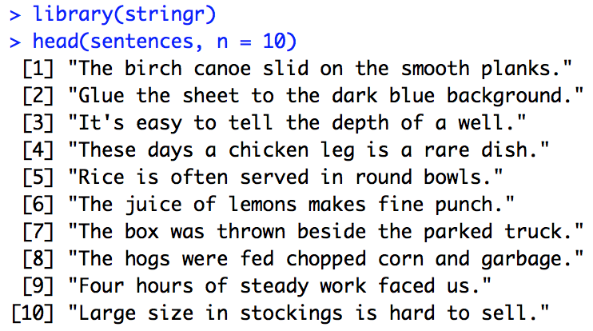
Harvard Sentences Dataset
The Harvard sentences are a collection of sample phrases that are used for standardized testing of Voice over IP, cellular, and other telephone systems. They are phonetically balanced sentences that use specific phonemes at the same frequency they appear in English.
https://en.wikipedia.org/wiki/Harvard_sentences

Slide 43
Extract Matches and a Basic Plot
#Search for Matches and a quick plot
colors = c("orange","blue","yellow","green","purple","brown","red")
color_expression = str_c(colors, collapse = "|")
color_expression
has_color = str_subset(sentences,color_expression)
has_color
matches = str_extract(has_color,color_expression)
matches
matches_all = str_extract_all(has_color,color_expression, simplify = TRUE)
matches_all
matches_all = unlist(str_extract_all(has_color,color_expression))
matches_all
matchDF = data.frame(Colors = matches_all)
matchDF %>% ggplot(aes(x = Colors, fill = Colors)) + geom_bar()
matchDF %>% ggplot(aes(x = Colors, fill = Colors)) + geom_bar()+ scale_fill_manual(values=colors)
colors[order(colors)]
matchDF %>% ggplot(aes(x = Colors, fill = Colors)) + geom_bar()+ scale_fill_manual(values=colors[order(colors)])

Slide 44
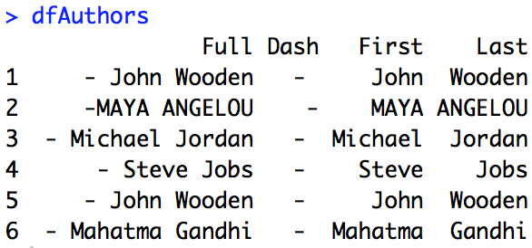
Grouped Matches
author = "( -| - )([^ ]{2,}) ([^ ]{2,})"
authors = df$quotes %>% str_subset(author)
authors %>% str_extract(author) #unintended consequence here
authors %>% str_match(author) #unintended consequence here
dfAuthors = data.frame(authors %>% str_match(author)) #unintended consequence here
names(dfAuthors) = c("Full","Dash","First","Last")

Slide 46
Concept Check with Sentences
Find all words that come after a number like “one”, “two”, ”three” etc. Pull out both the number and the word that follows.

Slide 48
Replacing
str_replace()

Slide 49
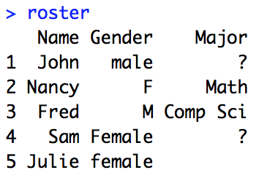
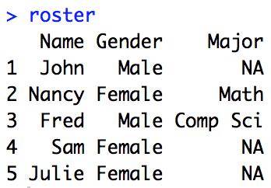
Replacing
#Create Data Frame with inconsistencies and missing values
roster = data.frame(Name = c("John", "Nancy", "Fred", "Sam", "Julie"), Gender = c("male", "F", "M", "Female", "female"), Major = c("?","Math","Comp Sci", "?", ""))
#Work on Gender
#Learn about str_replace
str_replace(roster$Gender,"(male|M)", "Male")
str_replace(roster$Gender,"(\\bmale\\b|\\bM\\b)", "Male")
#Use str_replace
roster$Gender = str_replace(roster$Gender,"(\\bmale\\b|\\bM\\b)", "Male")
roster$Gender = str_replace(roster$Gender,"(\\bfemale\\b|\\bF\\b)", "Female")
#You Try Change all the ? marks and null spaces to "NA".
str_replace(roster$Major,"(\\?|)", "NA")
roster$Major = str_replace(roster$Major,"(\\?)", "NA")
roster
roster[roster ==""] = "NA"
roster

Slide 51
Splitting
str_split()

Slide 52
Splitting
#Basic Demo of str split
str_split("Muhatma_Gandhi, John_Wooden, Maya_Angelou" , "(_|,)")
str_split("Muhatma_Gandhi, John_Wooden, Maya_Angelou" , "(_|, )")
#Look into the first object of the list (which is a string of strings)
str_split("Muhatma_Gandhi, John_Wooden, Maya_Angelou" , "(_|, )")[[1]]
#or
unlist(str_split("Muhatma_Gandhi, John_Wooden, Maya_Angelou" , "(_|, )"))
#Don't confuse with separate()
Authors = data.frame(Author = c("Muhatma_Gandhi", "John_Wooden", "Maya_Angelou"))
Authors %>% separate(Author,into = c("First", "Last"), sep = "_")
#Split string into words
s1 = sentences[1]
str_split(s1," ")
str_split(s1,"\\b")
str_split(s1,boundary("word"))
unlist(str_split(s1,boundary("word")))

Slide 53
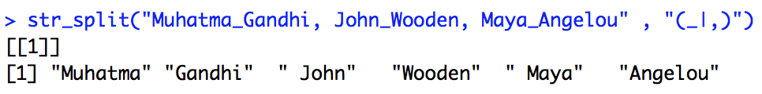
Splitting
#Basic Demo of str split
str_split("Muhatma_Gandhi, John_Wooden, Maya_Angelou" , "(_|,)")
unlist(str_split("Muhatma_Gandhi, John_Wooden, Maya_Angelou" , "(_|,)"))
unlist(str_split("Muhatma_Gandhi, John_Wooden, Maya_Angelou" , "(_|, )"))

Slide 55
Regular Expressions (the function)
regex()

Slide 56
regex()
#regex()
roster = data.frame(Name = c("John", "Nancy", "Fred", "Sam", "Julie", "Pat", "Mel", "Jay"), Gender = c("male", "F", "M", "Female", "femaLe","m","f","MaLe"), Major = c("NA","Math","Comp Sci", "NA", "NA", "NA", "English", "EE"))
roster
str(roster)
roster$Gender = str_replace(roster$Gender,"(\\bmale\\b|\\bM\\b)", "Male")
roster$Gender = str_replace(roster$Gender,"(\\bfemale\\b|\\bF\\b)", "Female")
roster
str(roster)
roster$Gender = str_replace(roster$Gender,regex("(\\bmale\\b|\\bM\\b)",ignore_case = TRUE), "Male")
roster$Gender = str_replace(roster$Gender,regex("(\\bfemale\\b|\\bF\\b)",ignore_case = TRUE), "Female")
roster$Gender = as.factor(roster$Gender)
roster
str(roster)

Slide 57
regex()
Turns out that the regex() call has been implied in every regular expression we have supplied thus far:
unlist(str_split("Muhatma_Gandhi, John_Wooden, Maya_Angelou" , "(_|, )"))
unlist(str_split("Muhatma_Gandhi, John_Wooden, Maya_Angelou" , regex("(_|, )")))

Slide 58
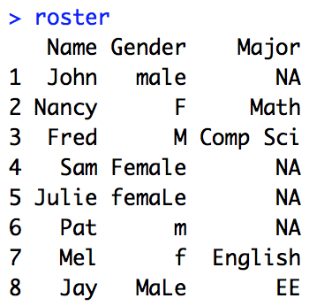
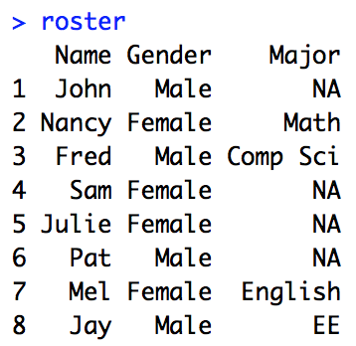
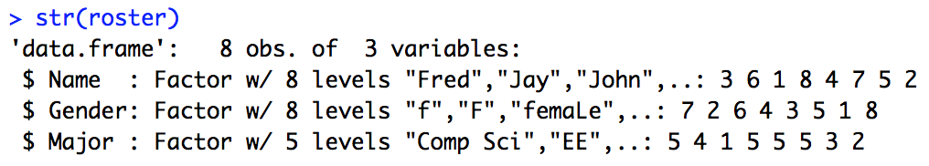
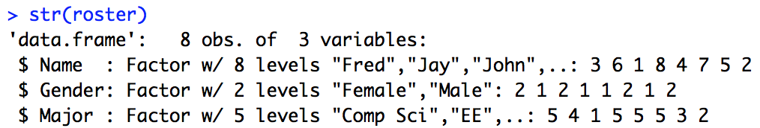
regex()
regex(pattern, ignore_case = FALSE, multiline = FALSE, comments = FALSE, dotall = FALSE, ...)
roster = data.frame(Name = c("John", "Nancy", "Fred", "Sam", "Julie", "Pat", "Mel", "Jay"), Gender = c("male", "F", "M", "Female", "femaLe","m","f","MaLe"), Major = c("NA","Math","Comp Sci", "NA", "NA", "NA", "English", "EE"))
roster$Gender = str_replace(roster$Gender,"(\\bmale\\b|\\bM\\b)", "Male")
roster$Gender = str_replace(roster$Gender,"(\\bfemale\\b|\\bF\\b)", "Female")
roster
str(roster)
roster$Gender = str_replace(roster$Gender,regex("(\\bmale\\b|\\bM\\b)",ignore_case = TRUE), "Male")
roster$Gender = str_replace(roster$Gender,regex("(\\bfemale\\b|\\bF\\b)",ignore_case = TRUE), "Female")
roster$Gender = as.factor(roster$Gender)
roster
str(roster)

Slide 60
NYT API | Getting a Key
We will make this a text page so we can change it if NYT changes their method of getting an API Key.

Slide 62
NYT Headline Analysis
The Goal

Slide 63
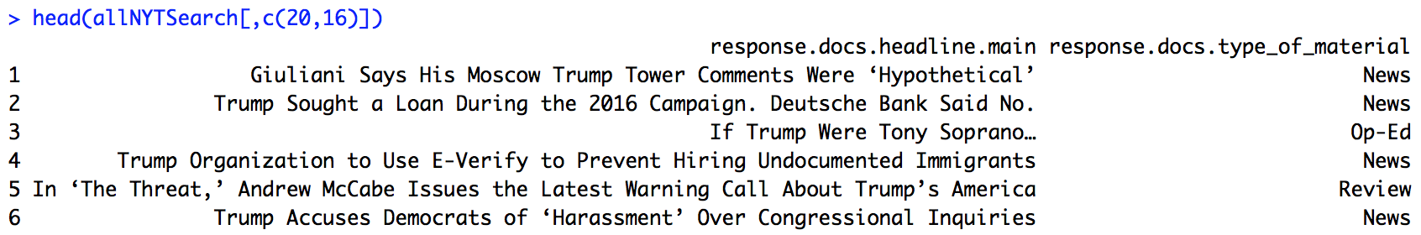
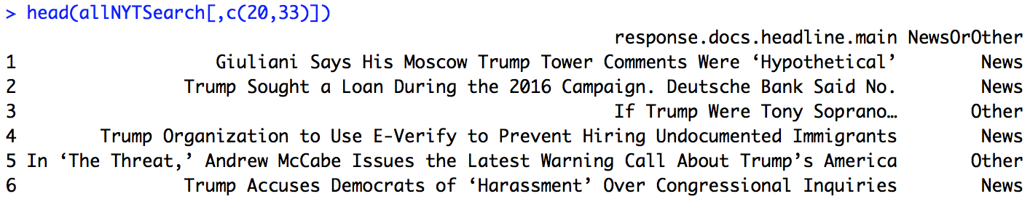
Example: NYT News/Other Classification
The New York Times classifies its articles as News, Op Ed, Obituary, etc.
The GOAL: We would like to be able to classify an article as a “News” article or not a “News” Article (we will call this “Other”).
#put word boundaries on them so that we don't detect partial words later
wordsToTakeOut = str_c(stopwords(),collapse = "\\b|\\b")
wordsToTakeOut = str_c("\\b",wordsToTakeOut,"\\b")
wordsToTakeOut
tokened = str_split(df$quotes[5],boundary("word"))[[1]]
quoteWords = tokened[!str_detect(tokened,wordsToTakeOut)]
str_count(df$quotes,quoteWords)

Slide 64
Example: NYT News/Other Classification
GOAL: NYT classifies its articles as News, Op Ed, Obituary, etc.
We would like to be able to classify an article as a “News” article or not a “News” Article (we will call this “Other”).
To do this, we will simply look at each word of the target article’s headline and calculate and record the percentage of “News” articles that contain that word and the percentage of “Other” articles that contain that word. We will classify the article as ”News” or “Other” based on the highest sum of percentages across all the words in the headline of the target article.
Here, article 5 has a higher sum of percentages for the ”Other” category so it was classified as “Other”.
#put word boundaries on them so that we don't detect partial words later
wordsToTakeOut = str_c(stopwords(),collapse = "\\b|\\b")
wordsToTakeOut = str_c("\\b",wordsToTakeOut,"\\b")
wordsToTakeOut
tokened = str_split(df$quotes[5],boundary("word"))[[1]]
quoteWords = tokened[!str_detect(tokened,wordsToTakeOut)]
str_count(df$quotes,quoteWords)

Slide 65
Example: NYT News/Other Classification
GOAL:
The NYT classifies its articles as News, Op Ed, Obituary, etc.
We would like to be able to classify an article as a “News” article or not a “News” Article (we will call this “Other”).
To do this, we will simply look at each word of the target article’s headline and calculate and record the percentage of “News” articles that contain that word and the percentage of “Other” articles that contain that word. We will classify the article as ”News” or “Other” based on the highest sum of percentages across all the words in the headline of the target article.
This not a great classifier, but it helps us demonstrate how regular expressions can be used with what we have learned so far.
Don’t worry, we will study better classifiers later!
#put word boundaries on them so that we don't detect partial words later
wordsToTakeOut = str_c(stopwords(),collapse = "\\b|\\b")
wordsToTakeOut = str_c("\\b",wordsToTakeOut,"\\b")
wordsToTakeOut
tokened = str_split(df$quotes[5],boundary("word"))[[1]]
quoteWords = tokened[!str_detect(tokened,wordsToTakeOut)]
str_count(df$quotes,quoteWords)

Slide 67
Example: NYT | Loading the Data
library(dplyr)
library(tidyr)
library(plyr)
library(jsonlite)
NYTIMES_KEY = "OG89fUubcS8FXofVrLA4dmIOHh5omiFa" #Your Key Here … get from NTY API website
# Let's set some parameters
term <- "Trump" # Need to use + to string together separate words
begin_date <- "20190119"
end_date <- "20190219"
baseurl <- paste0("http://api.nytimes.com/svc/search/v2/articlesearch.json?q=",term,
"&begin_date=",begin_date,"&end_date=",end_date,
"&facet_filter=true&api-key=",NYTIMES_KEY, sep="")
initialQuery <- jsonlite::fromJSON(baseurl)
maxPages <- round((initialQuery$response$meta$hits[1] / 10)-1)
pages <- list()
for(i in 0:maxPages){
nytSearch <- jsonlite::fromJSON(paste0(baseurl, "&page=", i), flatten = TRUE) %>% data.frame()
message("Retrieving page ", i)
pages[[i+1]] <- nytSearch
Sys.sleep(10)
}
allNYTSearch <- rbind_pages(pages)
#put word boundaries on them so that we don't detect partial words later
wordsToTakeOut = str_c(stopwords(),collapse = "\\b|\\b")
wordsToTakeOut = str_c("\\b",wordsToTakeOut,"\\b")
wordsToTakeOut
tokened = str_split(df$quotes[5],boundary("word"))[[1]]
quoteWords = tokened[!str_detect(tokened,wordsToTakeOut)]
str_count(df$quotes,quoteWords)

Slide 69
Example: NYT | Segmenting “News” and “Other”
# Visualize coverage by section
allNYTSearch %>%
group_by(response.docs.type_of_material) %>%
dplyr::summarize(count=n()) %>%
mutate(percent = (count / sum(count))*100) %>%
ggplot() +
geom_bar(aes(y=percent, x=response.docs.type_of_material, fill=response.docs.type_of_material), stat = "identity") + coord_flip()
#Make another column of News versus Other ... The labels
allNYTSearch$NewsOrOther = ifelse(allNYTSearch$response.docs.type_of_material == "News","News","Other")
#There is an NA in NewsOrOther
# Visualize coverage of News or Other
allNYTSearch[!is.na(allNYTSearch$NewsOrOther),] %>%
group_by(NewsOrOther) %>%
dplyr::summarize(count=n()) %>%
mutate(percent = (count / sum(count))*100) %>%
ggplot() +
geom_bar(aes(y=percent, x=NewsOrOther, fill=NewsOrOther), stat = "identity") + coord_flip()

Slide 71
Example: NYT | Identify Article to Classify and Tokenize Into Important Words
ArticleToClassify = allNYTSearch[5,]
trueType = allNYTSearch$response.docs.type_of_material[1]
library(tm) #text mining library provides the stopwords() function
stopwords()
#The [^[:alnum:] ] replaces all non alphanumeric characters with nulls.
theText = unlist(str_split(str_replace_all(ArticleToClassify$response.docs.headline.main,"[^[:alnum:] ]", ""), boundary("word"))) #Take out all but alpha numeric characters from search string
#put word boundaries stopwords so that we don't detect partial words later
wordsToTakeOut = str_c(stopwords(),collapse = "\\b|\\b")
wordsToTakeOut = str_c("\\b",wordsToTakeOut,"\\b")
wordsToTakeOut
importantWords = theText[!str_detect(theText,regex(wordsToTakeOut,ignore_case = TRUE))]
importantWords

Slide 73
Example: NYT | For Each Word, Find the Corresponding Percent in “News” / “Other”
newsArticles = allNYTSearch %>% filter(NewsOrOther == "News")
otherArticles = allNYTSearch %>% filter(NewsOrOther == "Other")
numNewsArticles = dim(newsArticles)[1]
numOtherArticles = dim(otherArticles)[1]
thePercentHolderNews = c()
thePercentHolderOther = c()
for(i in 1 : length(importantWords))
{
numNews = sum(str_count(newsArticles$response.docs.headline.main[-1],importantWords[i]))
numOther = sum(str_count(otherArticles$response.docs.headline.main[-1],importantWords[i]))
thePercentHolderNews[i] = numNews / numNewsArticles
thePercentHolderOther[i] = numOther / numOtherArticles
thePercentHolderNews
thePercentHolderOther
}
thePercentHolderNews
thePercentHolderOther

Slide 75
Example: NYT | Classify
classifiedAs = if_else(sum(thePercentHolderNews)>sum(thePercentHolderOther),"News","Other")
sum(thePercentHolderNews)
sum(thePercentHolderOther)
Result = str_c("The article was classified as ", classifiedAs, " with a News score of: ",round(sum(thePercentHolderNews),4), " and an Other score of: ", round(sum(thePercentHolderOther),4), ".")
Result

Slide 76
Example: NYT | Visualize
articleStats = data.frame(Word = importantWords, newsScore = thePercentHolderNews, otherScore = thePercentHolderOther)
articleStats[,c(2,3)] %>% gather(Type,Percent) %>% mutate(Word = rep(articleStats$Word,2)) %>% ggplot(aes(y = Percent, x = Type, fill = Word)) + geom_col()
articleStats[,c(2,3)] %>% gather(Type,Percent) %>% mutate(Word = rep(articleStats$Word,2)) %>% ggplot(aes(y = Percent, x = Type, fill = Word)) + geom_col() + facet_wrap(~Word)

Slide 78
For Live Session

Slide 79
For Live Session
1. On 3-5 PowerPoint slides and using the NTYFlight13 datasets, complete Exercises 1 – 5 from the Wickham text.
2. Using the sentences dataset from stringr (that we used in this Unit) find all contractions and separate out the pieces before and after the apostrophe. Make a bar plot showing the frequency of the piece after the contraction.
3. Using the NYT dataset from the last example, create an additional visualization. Bonus: If you have time, improve the classifier if you have an idea of how to do so.
3b. adapt the NYT code to first remove the article that is being classified from the article that are being searched through to derive the percents. For instance, if the word “Palm” is only in the article we are trying to classify (let’s say it was an ”Other” article), it would not be fair to use that article in the classification process.
4. Use the Twitter API to download tweets and analyze the frequency of positive and negative words to judge sentiment. You will need the tidytext package and you can get a list of words that have been tagged as positive and negative using the function call get_sentiment(“bing”). https://www.tidytextmining.com/sentiment.html You may choose the population of tweets you want to assess. Examples would be: a) the last 24 hours b) from the time of Hurricane Katrina c) from two Norman, OK and Austin Texas after the Texas / OU game, etc.
helpful twitteR functions are: searchTwitter(), twListToDF(), availableTrendLocations()
https://www.rdocumentation.org/packages/twitteR/versions/1.1.9/topics/searchTwitter
b = searchTwitter('Cowboys', geocode='32.7767,-96.7970,10mi’) #Dallas Cowboys in with 10 miles of Dallas)
Dallas is geocode='32.7767,-96.7970,10mi You can find other geocodes with a simple Google look up.

